Slide 1
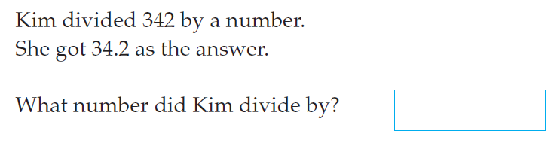
5 questions
Find the mode and range of: 9, 10, 8, 10, 11, 11, 8
If three sides of a triangle measured 8cm, 8 cm, 10 cm. What name can we give it?
Draw a vertically opposite angle to the one shown
what is the range of this data
.
3 | 1, 5, 6
4 | 0, 0, 2
5 | 3, 1, 8

Slide 2
Data
EQ: how can we find the mean, median, mode and range from graphs?
 | In your Cornell Notes… redraw the table and make sure the definitions are in the correct spot.
Median | Highest score – lowest score
Mode | Arrange numbers in order and find the middle number
Range | Add up all the numbers and divide by how many numbers there are
Mean | Most common number

Slide 3
Data
EQ: how can we find the mean, median, mode and range from graphs?
 | Using the stem and leaf plot below find Mean – Median – Mode – Range -
3 | 1, 2, 5
4 | 0
5 | 3, 7
6 | 8, 8

Slide 4
LHS
2 | 3, 3
3 | 6
4 | 1, 2, 8
5 | 0
MEAN –
MEDIAN –
MODE –
RANGE -

Slide 5
Data
EQ: how can we find the mean, median, mode and range from graphs?
 | Using the dotplot below find 0 1 2 3 4 5 6 hours watching tv Mean – Median – Mode – Range -

Slide 6
LHS
2 3 4 5 6 score /10
MEAN –
MEDIAN –
MODE –
RANGE -

Slide 7
Complete the worksheet attached

